Slide 1
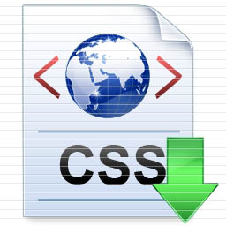
Presentation
Group 2

Slide 2
1. Introduction
What is CSS?
→ Cascading Style Sheets
→ A style sheet language used for describing the look and formatting of a document written in a markup language
→ Often used to change the style of web pages and user interfaces in HTML and XHTML

Slide 3
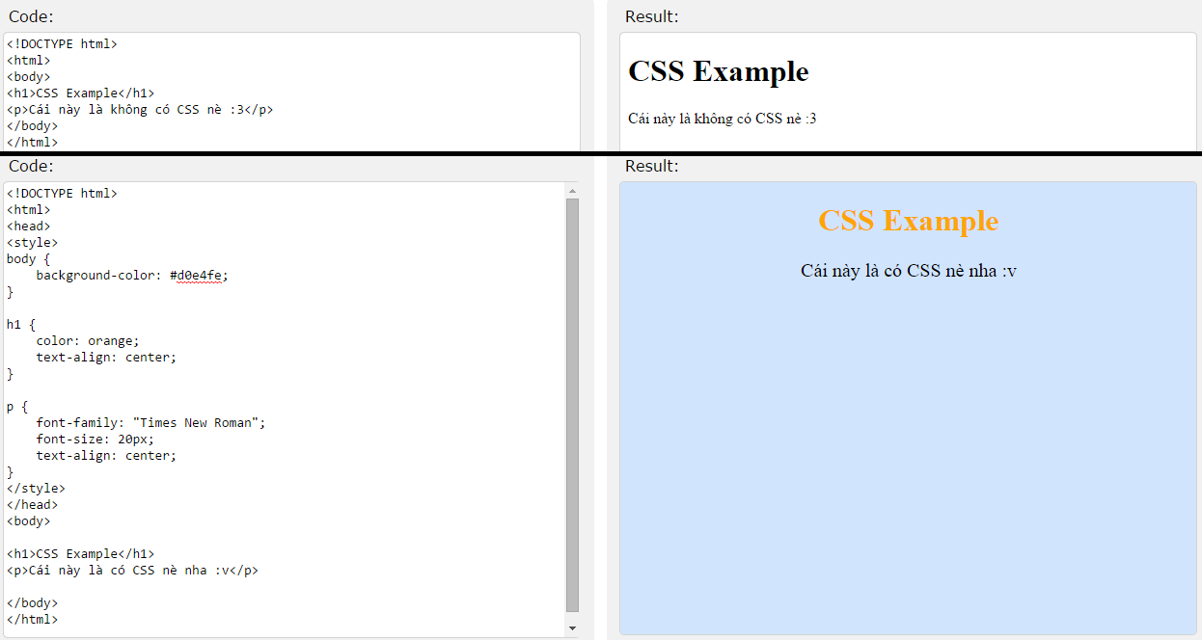
Ex :

Slide 4
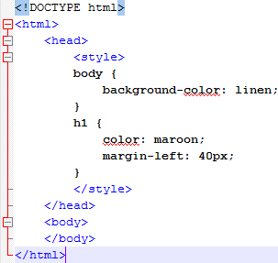
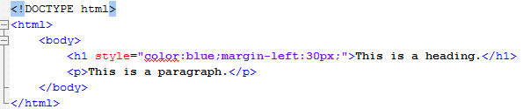
2. Insert CSS
1 . Internal style sheet
2 . Inline style

Slide 5
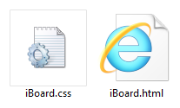
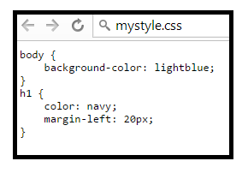
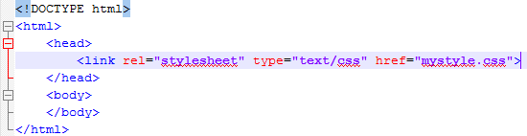
2. Insert CSS
3 . External style

Slide 6
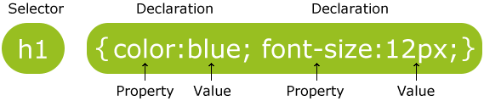
3. Syntax
The selector points to the HTML element you want to style
The declaration block contains one or more declarations separated by semicolons
Each declaration includes a property name and a value, separated by a colon

Slide 7
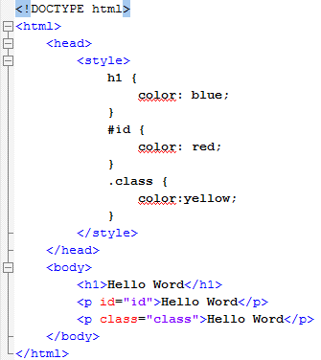
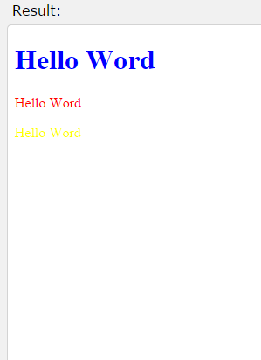
4. Selector
Selector :
Element
Id
Class

Slide 8
5. Properties & values

Slide 9
More about CSS
http://www.w3schools.com/html/
Thanks for listening.

